Slide 1
TOEIC 250
LESSON 4

Slide 2
ADJECTIVES – (ADJ.)
SUFFIXES
FUNCTIONS
POSITION
COFUSING ADJECTIVES
COMMON EXPRESSIONS OF ADJECTIVE IN THE TOEIC TEST

Slide 3
FUNCTIONS OF ADJECTIVES
1. Modifying a noun a difficult decision (The adjective difficult modifies the noun decision.)
2. Modifying a subject or an object: it functions as a complement The service was very good.
(The adjective good modifies the subject the service.)

Slide 4
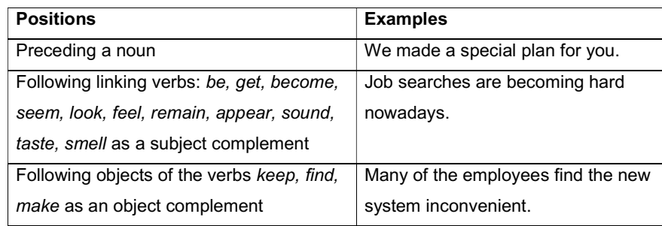
POSITION OF AN ADJECTIVES

Slide 5
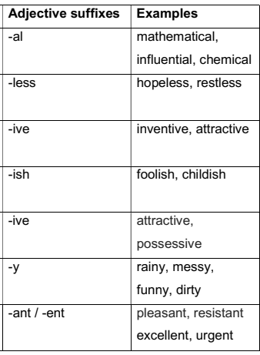
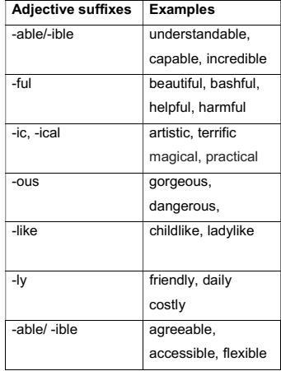
ADJECTIVES SUFFIXES

Slide 6
CONFUSING ADJECTIVES
Considerable: đáng kể, lớn lao | Considerate: thận trọng, chu đáo
Successful: thành công | Successive: kế tiếp
Terrible: tồi tệ | Terrific: tuyệt vời
Favorite: được yêu thích | Favorable: thuận lợi
Awful: khủng khiếp | Awesome: tuyệt vời

Slide 7
Common expressions of adjective in the TOEIC test
- Adj + that | I’m glad that you came. It’s important that we work together
- Adj + to | We’re happy to be here. I was shocked to see him.
Adj + preposition + V -ing | She is good at playing tennis. I’m tired of listening to this music
Be aware of : có ý thức về … | Be likely to: có khả năng xảy ra , có lẽ
Be eligible for : đủ tư cách, đủ tiêu chuẩn để… | Be ready to: sẵn sàng làm gì
Be able to : có thể làm đươc gì | Be responsible for: chịu trách nhiệm về …
Be capable of: có khả năng làm gì | Be subject to: phải chịu, phải tuân threo, bị

Slide 8
Practice
A. Place the adjectives in brackets in the correct position - (A), (B), (C)) or (D).
1. (various) A Companies B attended C the D fair. 2. (useful) This pamphlet A gives B information on C online D shopping. 3. (difficult) The A work B became C very D. 4. (useful) A I B found C it D 5. (convenient) Find A a B way C to do D the work. 6. (expensive) A H&P Co. B sells C products D

Slide 9
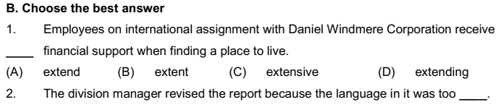
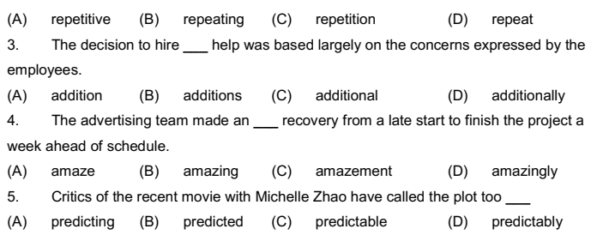

Slide 10
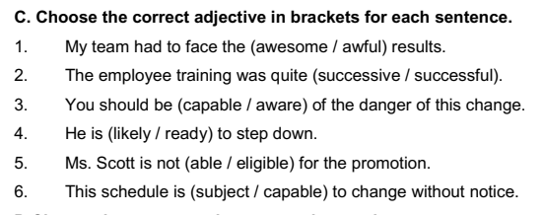

Slide 11
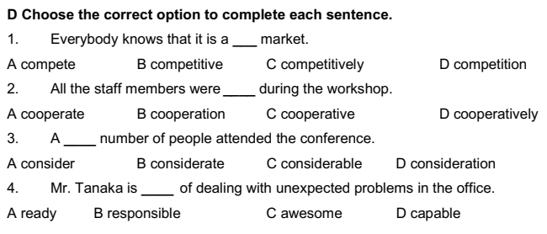

Slide 12
LISTENING
Dates and Time

Slide 13
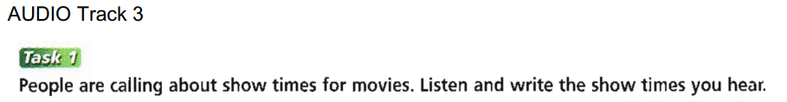
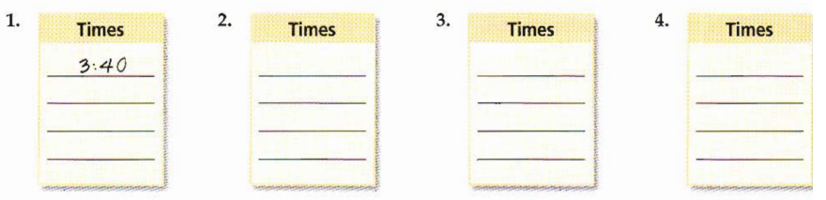
Cinema A
3:40
5:45
7:55
10:15
Cinema B
4:30
6:40
8:30
10:45
Cinema C
3:00
4:40
6:30
8:15
Cinema D
3:20
5:10
7:20
9:40

Slide 14
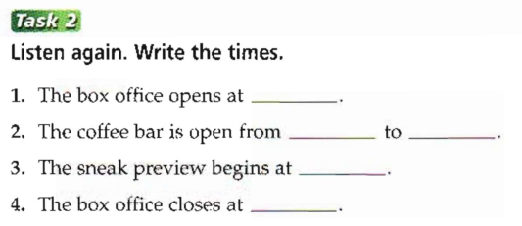
2:30
2:30
10:30
10 o’clock
9:55

Slide 15
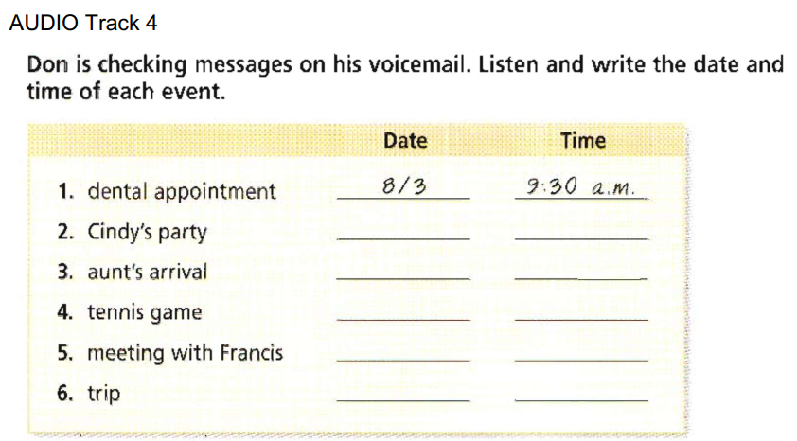
July 28th
8 p.m
August 10th
11:15 a.m
Sunday July 26th
3 p.m
Tuesday
September 22nd
6 p.m
August 2nd
2 p.m

